Slide 1
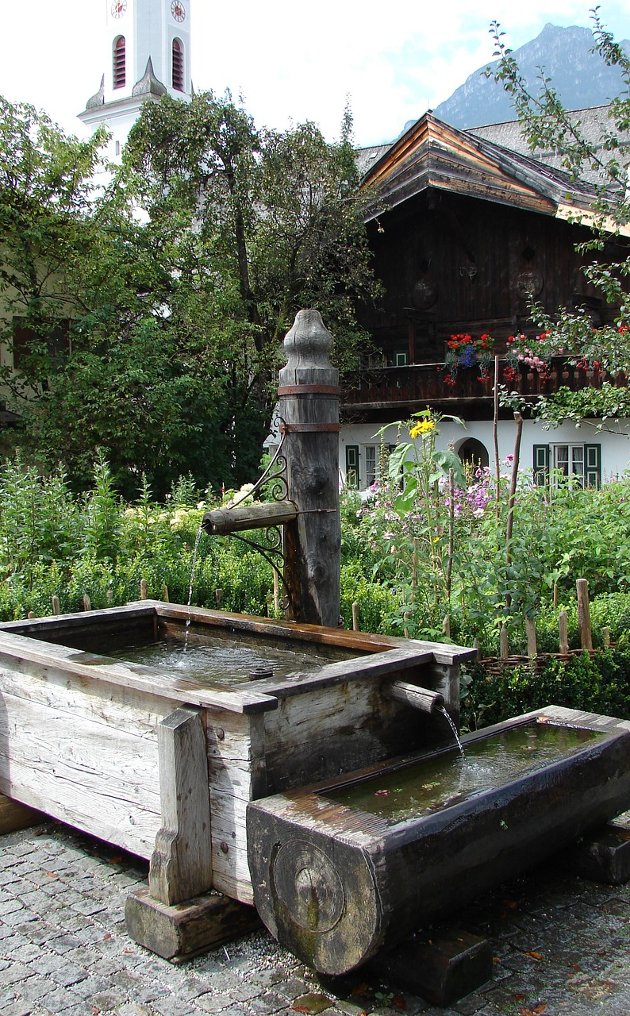

FRONTLINE
JUNE 2023
EUROPE 2023 – SPIRITUAL WELLS

Slide 2

In This FRONTLINE
Europe 2023 – Spiritual Wells Pages 3 - 5 | Karlsruhe, Germany Page 6 | Denmark: Copenhagen (Sealand), Aalsborg (Juteland), Sonderborg (Juteland) Page 7
Royston England & Scotland Page 8 | Peckham, England Page 9 | Shared Thoughts from TWC Travelers Pages 10 - 13
Coach’s Corner: The Best Words Are Always His Words For You! By Jean Nulty Page 14 | Training Highlights: New Horizons Page 15 | Mid-Year Ebb Pages 16 - 17
For a print friendly version go to TWC Website: Resources’ tab, Publications, Frontline
2023 The Warrior Commission © 2023 Frontline This journal is for The Warrior Commission members,
who may print it for personal use & share with friends via email. Written permission is required for any
other purpose, for part or all, of its contents. Pictures used from Pixabay, Unsplash, and Pexels.

Slide 3


Europe 2023 – Spiritual Wells
Where to begin but with Thanks? Thanks to the Lord for bringing us to this point. A special thank you for your prayers, prophetic Intel, and encouragement. Thanks to Byron and Crystal Easterling for being connectors and for the years of sowing into so many. And grateful thanks to the many different people we met along the way, who welcomed us into their homes, introduced us to their friends and opened their hearts to what’s possible with God. We are forever grateful.
Beginnings
This trip started as a heart-dream to pour into our Warriors in the United Kingdom (UK). They have been faithful to come to the States and join us along the way at our events. Sharon and Christine remember the conversation several years ago where we started dreaming and praying with God. We started putting money aside then and prayed for God’s timing. Then, through conversations about it, Byron felt led to invite us to connect to others in the UK and the European Union (EU). As Kathy and Angela prayed, they also felt led to join in on the journey.
Our trip took us to these areas: Karlsruhe, Germany; Copenhagen (Sealand), Denmark; Aalsborg (Juteland), Denmark; Sonderborg (Juteland), Denmark; Royston, England; and Peckham, England. We left on May 2 and this portion of our adventure came to a close on May 23rd.
The Team
Byron and Crystal Easterling made introductions to people they have been running with for many years. For the past 10+ years, they have spent blocks of weeks and months in Europe. Over the years, they often absorbed the costs to stay with these friends and develop stronger relational bonds. Friendship takes time, and consistency, to build.
Byron and Crystal were gracious to help us navigate the different landscapes and cultures, helping us connect to the person’s story and journey, even before we met. We were only able to meet these pioneers of the faith because of the trust they had built. Without that ground being laid, and their value for people over the years, we would not have had the opportunity to meet these powerful brothers and sisters in Christ.
2023 The Warrior Commission © 2023 Frontline This journal is for The Warrior Commission members, who may print it for personal use
& share with friends via email. Written permission is required for any other purpose, for part or all, of its contents

Slide 4
Angela, Kathy, Sharon, and Christine joined in the journey. Two had traveled to Europe before, but two had not. We saw different strengths come out over the three weeks we spent together. Overall, it was a wonderful experience for us to bond as a team and get to know each other deeper. Although each of us had a chance to encourage and prophesy to different people along the way, we also worked together in a way we had not done before. Each of us felt we had received upgrades in the journey that we are still identifying and unpacking. (See their Frontline articles for their perspectives and take-aways.)
At times, the introverted components of who we are came out and needed just a little time to process and refresh. Other times, the extroverted aspects of our hearts were able to thrive and connect. For us, it was similar to Champion Training – we were stuffing our backpacks and carry-ons with as many nuggets, revelation, and prophetic insights as we could along the way. It seems we actually came home with a few extra cases of spiritual luggage, (not baggage).
You were also part of this adventure. Your prayers, Intel and the Impact Prayer encouraged and supported us along the way. Wells, Humility, Harmony…all were key words in our Intel process. Our EU and UK Warriors made special efforts to connect and/or come to our TWC Royston Event. Having the Face2Face time was so fantastic, joyful and lovely.
In addition, in our spiritual luggage, Kingdom treasures are going to be opened and shared as we all process through the journey together over the next months and years. ☺
Wells
At each stop, we heard mention of wells. By the second or third stop, talk of wells being discovered, uncapped, and re-dug became apparent. We got to see several of these wells physically. The wells had spiritual ramifications. Even though some were real and others were unseen in the natural, all were important as we joined in with our new friends to celebrate the uncapping and discovery of these ancient wells on their lands and in their countries.
Along our journey, we connected to people who are shaking a bit with the present situation and are trying to understand this current move of God – but, just like us, they want more! We also found others who are already dreaming and running their unique journey in the New Era landscape with us. No matter what the situation, we entered into each group with open hearts, expectations for God’s heart to be seen and humility for whatever direction God decided to lead.
Kingdom treasures (from Europe) will be opened and shared across TWC.
2023 The Warrior Commission © 2023 Frontline This journal is for The Warrior Commission members, who may print it for personal use
& share with friends via email. Written permission is required for any other purpose, for part or all, of its contents

Slide 5
With each group we met, we sought to understand identity. Identity of a nation. Identity of the group. And identity of the individual. Why? God is restoring people back to their original call and purpose - which means knowing their God-given identity is key. To know the identity of a nation partners with who God says they are. To partner with individual identity pulls in favor and ease of connection. To partner with both at the same time engages connection with powerful Kingdom freedoms, promises and permissions. It’s so exciting!
Posture
We were expectant for God to move, but we put no constraints or demands on Him. We only wanted to see His heart and find the encouragement He had on hand. Humility is key. Honoring where each group is, along with the strategic decisions they have at hand, allows us to simply learn more about them, encourage, and connect.
We also hope to continue in the dynamic exchange we experienced on the trip – conversations were numerous. Questions were asked. Discoveries were made. Things were solidified. We learned a lot about their cultures and how Kingdom culture is being explored and pursued in multiple nations in Europe. We learned a lot about ourselves. We are humbled and expanded because of it. (More on each nation and what we discovered to come).
Who knew when we set out about a month ago, how we would grow, explore, and expand? We know that, over time, these new upgrades will filter into our conversations, training, and development.
Breakthrough and Upgrades
The conversations brought breakthrough for us and, hopefully, made positive contributions for those we met. The deposits God made in us, through us and around us were beyond amazing. Now we all have a chance to unpack and steward what God gave us.
We do ask for grace for us as we go through a bit of a wonky time of transition. Just so you have a better understanding of the transformation God brought along the way -- Before our EU/UK adventure came to a close on the third leg of our journey, the question was asked if anyone on our team had an upgrade…we all said, “yes.” Now, to uncover what those upgrades are and mean for each of us, and for our Tribe, in this TWC New Era adventure!
We are all becoming a version of beautiful – like Jesus.
2023 The Warrior Commission © 2023 Frontline This journal is for The Warrior Commission members, who may print it for personal use
& share with friends via email. Written permission is required for any other purpose, for part or all, of its contents

Slide 6
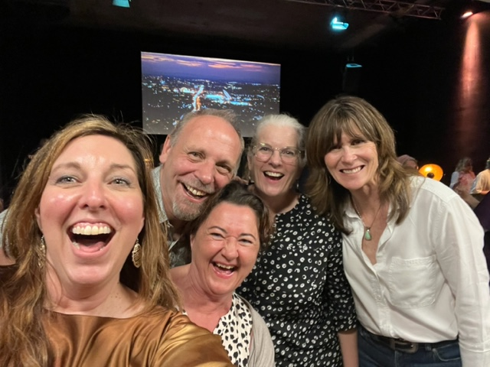
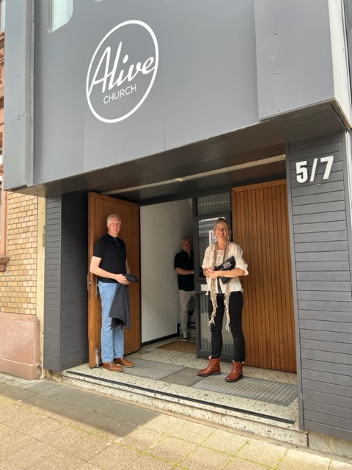
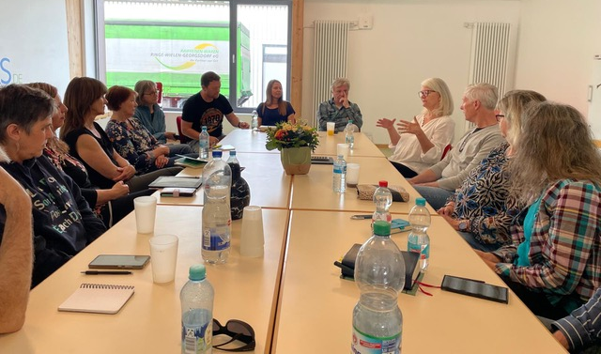
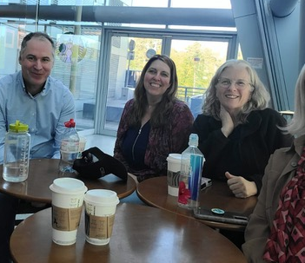
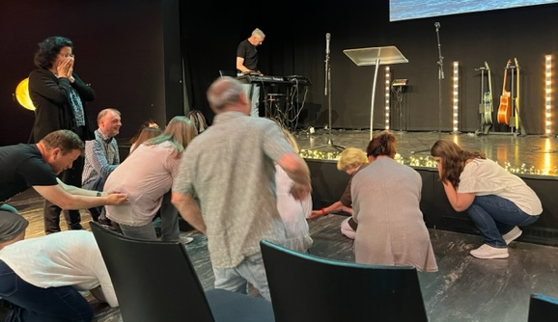
Karlsruhe, Germany
While there, we met with leaders of this church and several others. We also had several round table discussions, with prophetic coming forth from many who were there. Some shared dreams they had, from now, and many years ago. Others shared insight, journey and story and explored more regarding the current move of God.
We had two different round table discussions and dinner with some of the elders. We were invited to share some of those things to encourage the body at a Sunday evening church service.
One story shared, at one of the round tables, was from a group that formed over Covid as they would meet people walking along trails in the Black Forest. At some point, they began to gather. They would meet to worship, pray, and connect in a time when most were isolated and feeling alone. That group is still meeting.
We were able to spend some time with Tobias Knospe, who traveled to the Frankfort airport, as the team gathered from their different flights before getting on the train to Karlsruhe. Alan and Ellen Baker drove 2+ hours, after returning from Africa, to spend Sunday night and Monday with us in Karlsruhe. We made some good memories as we spent time with these Warriors and got to know them better. So grateful for our TWC online community format that creates chances to build connection – distant locations are irrelevant . Our God-based friendships are established because there is no distance in the Spirit. To listen to an audio of this meeting, go to https://Fabrik.church/media - scroll down to Prophetie Fabrik und Karlsruhe with Byron Easterling as the speaker.
The people we met in Karlsruhe are in transition. Much is shifting as the senior leaders are stepping into a different role. The current leaders, and a new one who might be joining them, are dreaming with God for what is possible. They are a group that is dedicated to what comes next and hopeful for the future of all God has. They know their values and, in the process, felt like God allows us to modify our Europe/UK Impact Prayer. Christine spoke it over them as a prophetic word.
2023 The Warrior Commission © 2023 Frontline This journal is for The Warrior Commission members, who may print it for personal use
& share with friends via email. Written permission is required for any other purpose, for part or all, of its contents

Slide 7
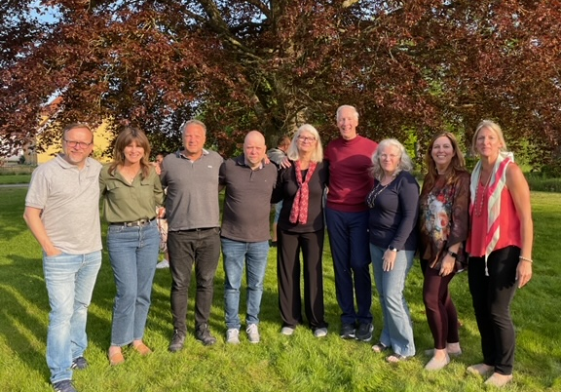
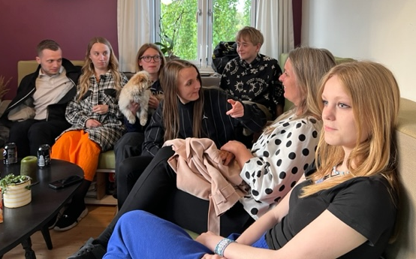
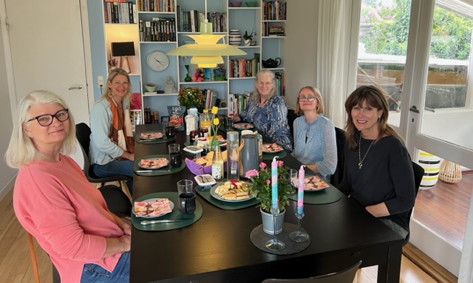
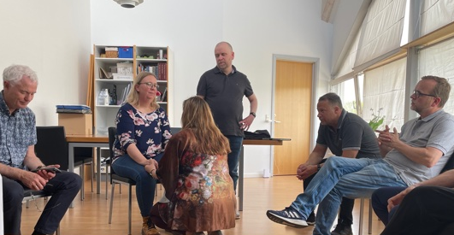
Denmark: Copenhagen (Sealand), Aalsborg (Juteland), Sonderborg (Juteland)
We took a train to Copenhagen from Karlsruhe. The downtime allowed us time to rest and refresh as Denmark was shaping up to have a full schedule. We stayed in 4 hotels/Airbnb’s during our time there, so we moved around quite a bit in the nine days we were there.
We met with leaders from many different churches, along with leaders who were part of a network, created from the Welsh Revival. We were invited into homes to enjoy meals, have discussions, hear stories and meet families and people from many generations. We took a trip with several leaders to Juteland and met many more people passionate for God. Some of the conversations included how God is moving in their country and what they are doing to bring restoration between nations.
One of the stories we heard involves forgiveness and restitution. There is a convent of German nuns who have been praying for forgiveness from God and restitution for Germany since World War 2. 70 years of prayers and sacrifice on behalf of a county. It seemed their heavenly bowls had filled up and God said it was time to pour those bowls out. Several of the people we met had taken God’s prompting to travel there and bless the nuns.
They gathered gourmet ingredients, flowers, china, and fine linens. They cooked and set beautiful tables for the nuns. Many of the nuns shared how they never thought they would experience and taste elegant food like this. They were so blessed.
But, then came the powerful moment. Our fantastic Denmark friends asked for their forgiveness, on behalf of Denmark, for holding unforgiveness in their hearts toward the German people and nation. The nuns were overwhelmed to see this act of service and request for forgiveness. They felt their prayers were being answered and restitution of nations is at hand. The 70 years of prayer were coming to reality and being answered before their eyes. As our friends left, the nuns danced and sang for joy to Jesus. This powerful moment of humility seems to have been a trigger to open the spiritual wells in Denmark. Much is bubbling and happening there.
2023 The Warrior Commission © 2023 Frontline This journal is for The Warrior Commission members, who may print it for personal use
& share with friends via email. Written permission is required for any other purpose, for part or all, of its contents

Slide 8
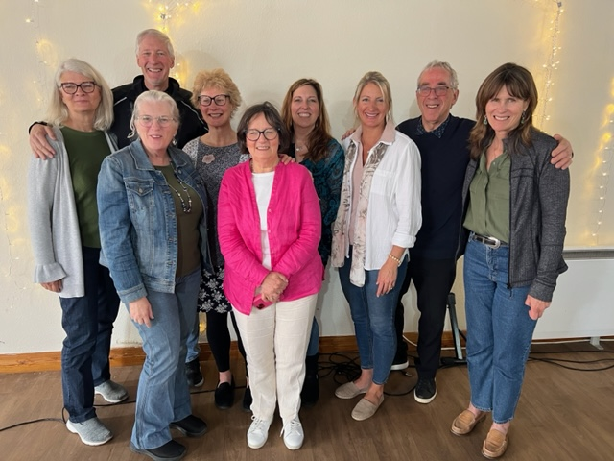
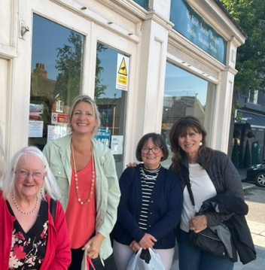
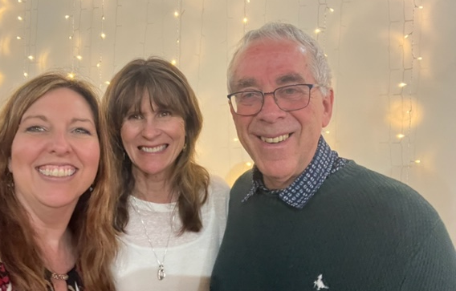
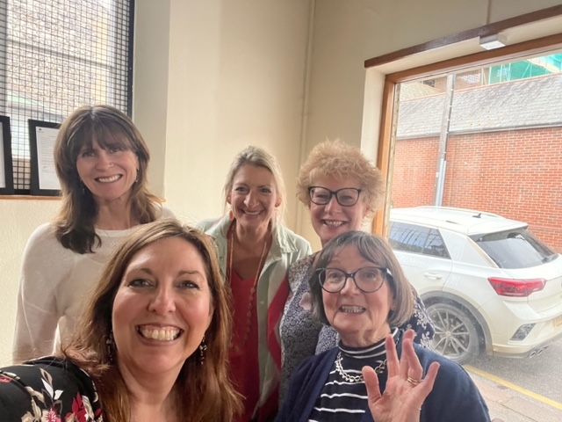
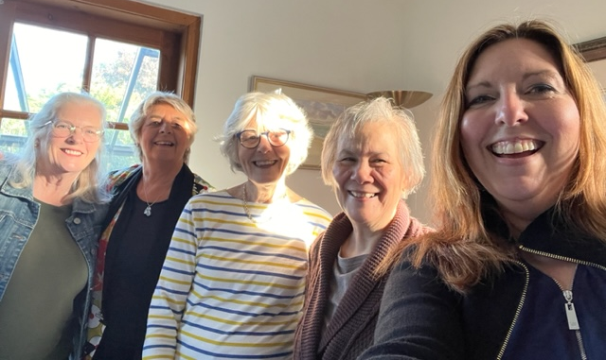
Royston England & Scotland
God’s presence was strong. Even as the worship leaders (who are also the pastors at the church) led worship, the air was thickening with the majestic presence of God. Our Warriors came early so we could talk and see each other. Laughter was heard, excitement was high, and God revealed Himself in some powerful ways.
Friday night, Byron connected us together. He prayed for our relationships and that the TWC and Royston folks would get to know each other well. Christine spoke on hunger and transformation. Then we went out to a local pub to continue to visit and hang out.
The next day, Sharon spoke on identity and intimacy. Kathy spoke on overcoming challenges. Angela did a prophetic activation with images God provided through a dear friend of Jean Nulty’s. Each talk built on the last. Each person walked away with something to take with them, and several activation times to take deeper with the Lord.
One of the ladies who attended had only been a believer for a few weeks. She was so hungry for the Lord. She volunteered to hold her picture of a bunch of yellow sunflowers up. We all took time to speak into what we felt God released in our hearts using the picture as a starting point. She was so blessed and was writing and recording everything.
That evening, we had dinner at the pastor’s house. They were gracious to invite the TWC folks who were staying the night. Along with those traveling from the States, the Warriors and their guests who attended our event were Rachel Hewitt, Andrew (and Caroline), and Jean Nulty and her friend Jean. We also had more people, from the church, who joined us.
We held our TWC UK event at a church building, built in the 1200s. It was originally a school at a monastery. Though it has been many things over the years, most of its use has come through Christian organizations. You can feel the prayers of the saints in the atmosphere.
2023 The Warrior Commission © 2023 Frontline This journal is for The Warrior Commission members, who may print it for personal use
& share with friends via email. Written permission is required for any other purpose, for part or all, of its contents

Slide 9
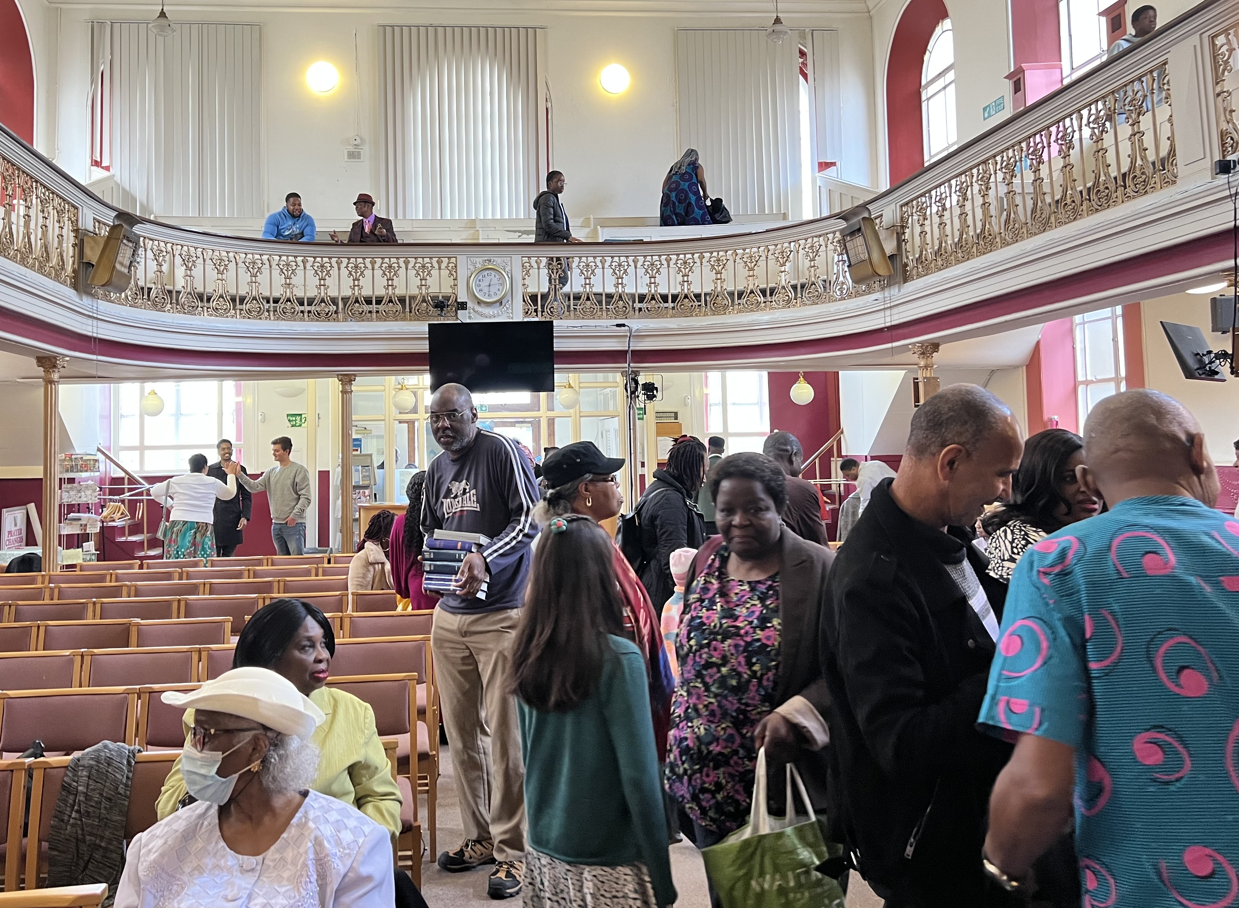
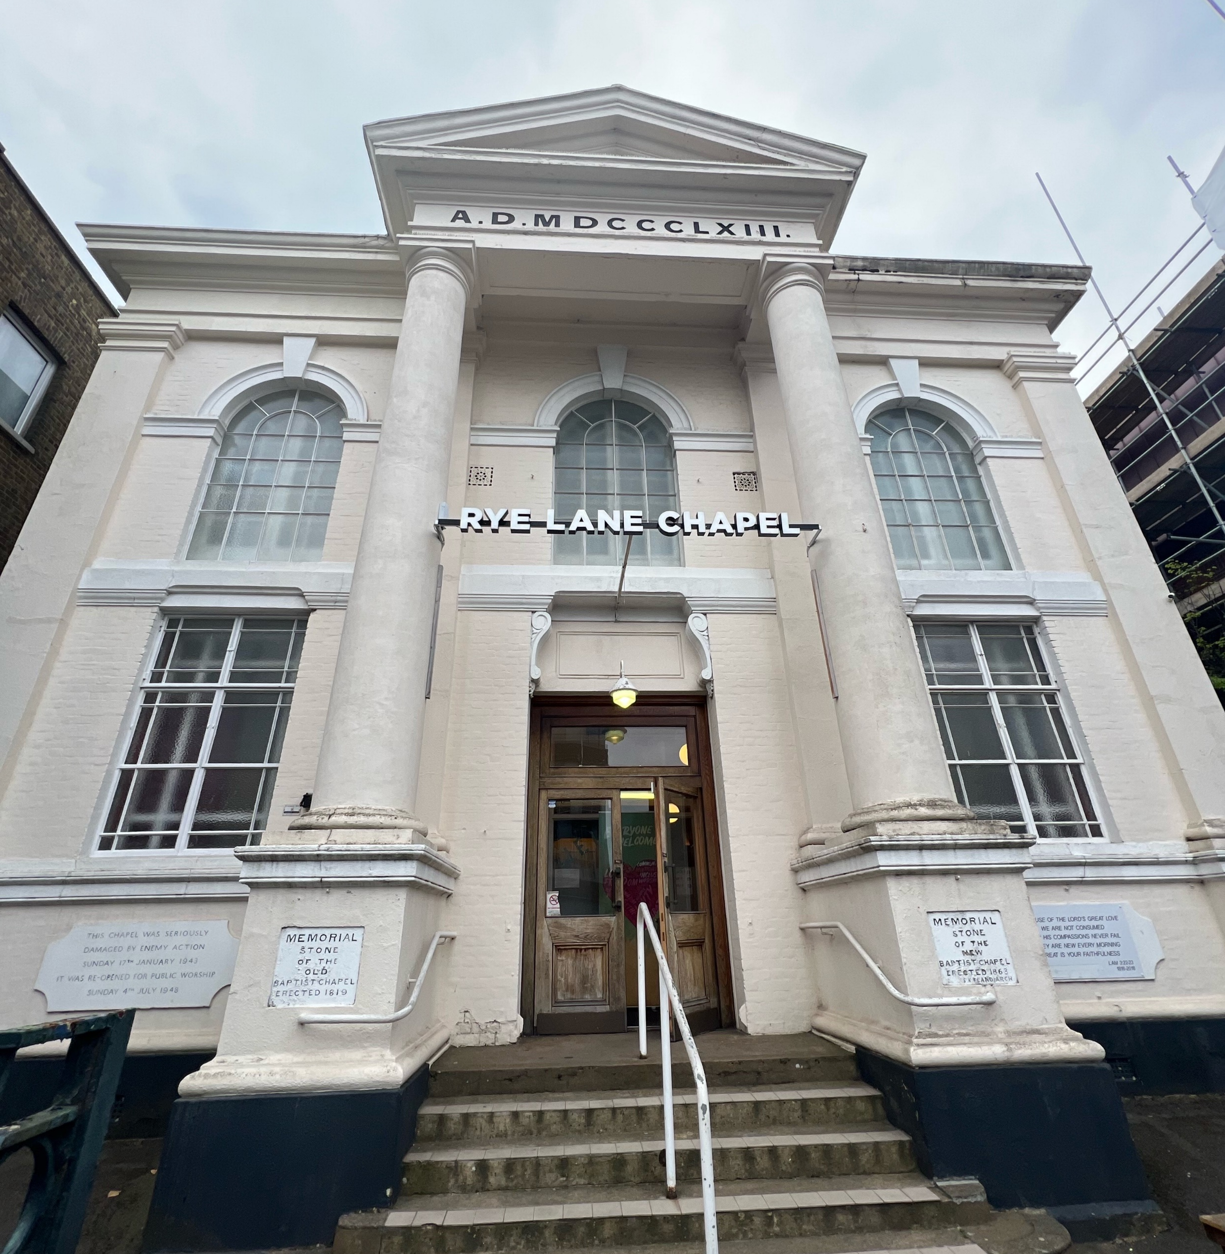
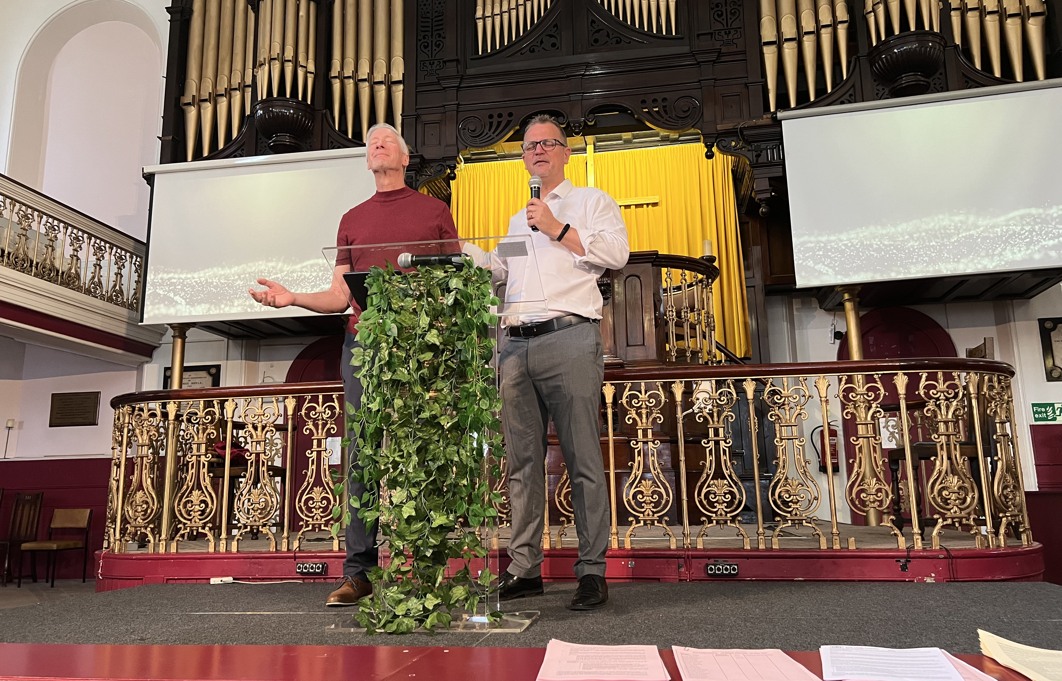
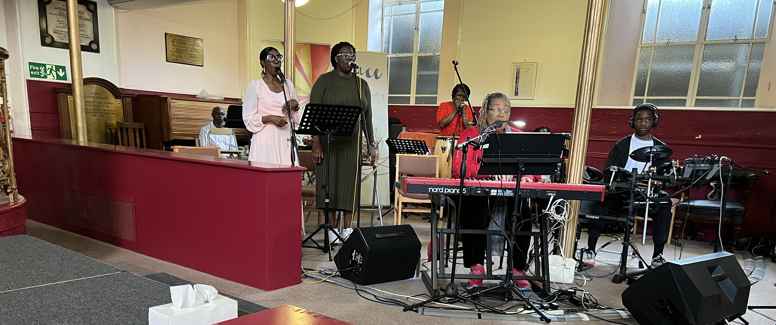
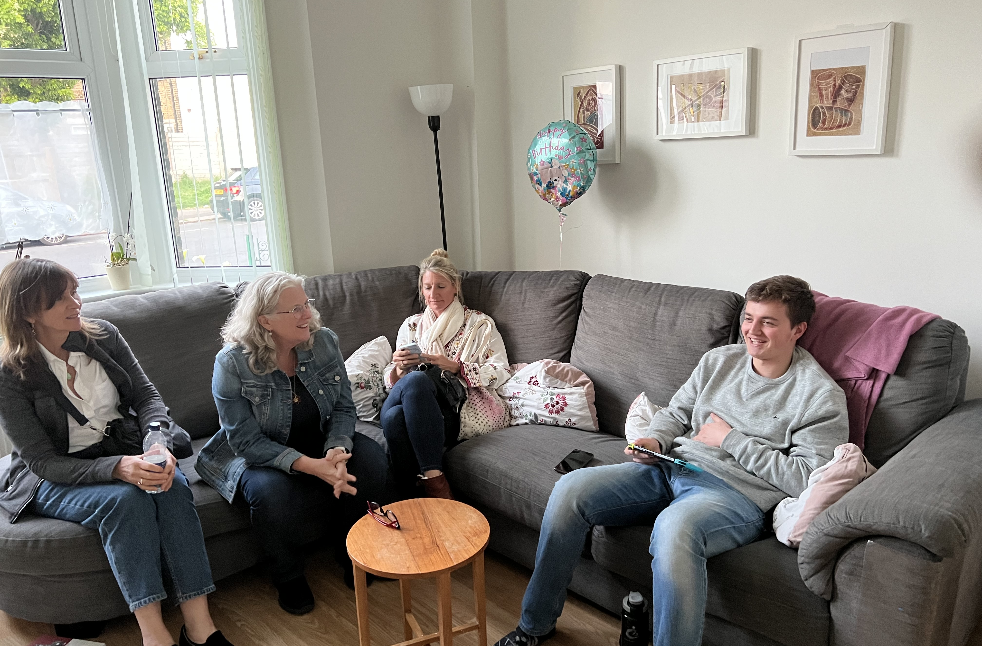
Peckham, England
It was a wonderful time of sharing and getting to know each other deeper. The church had a business meeting from 12-3 so we were not sure how many would come back to the evening service. The church was new to the prophetic, so we were there more to answer questions they about it than to operate in it.
The group was very welcoming and kind. We discovered some of the people there are focused reaching people in local gangs and/or women in multiple countries who need training and/or help in starting businesses and getting jobs. They are a passionate group of people with great hearts to see God move.
We look forward to strengthening the budding friendships we were blessed to start on our 2023 adventure.
We were invited to go to Peckham, a suburb of London on Sunday. Byron spoke about prophecy, and we then had a terrific lunch at the pastor’s home behind the church. Our original plan was to take the afternoon and go sightseeing, but we felt the Lord’s heart to stay and visit with the family, instead.
2023 The Warrior Commission © 2023 Frontline This journal is for The Warrior Commission members, who may print it for personal use
& share with friends via email. Written permission is required for any other purpose, for part or all, of its contents

Slide 10
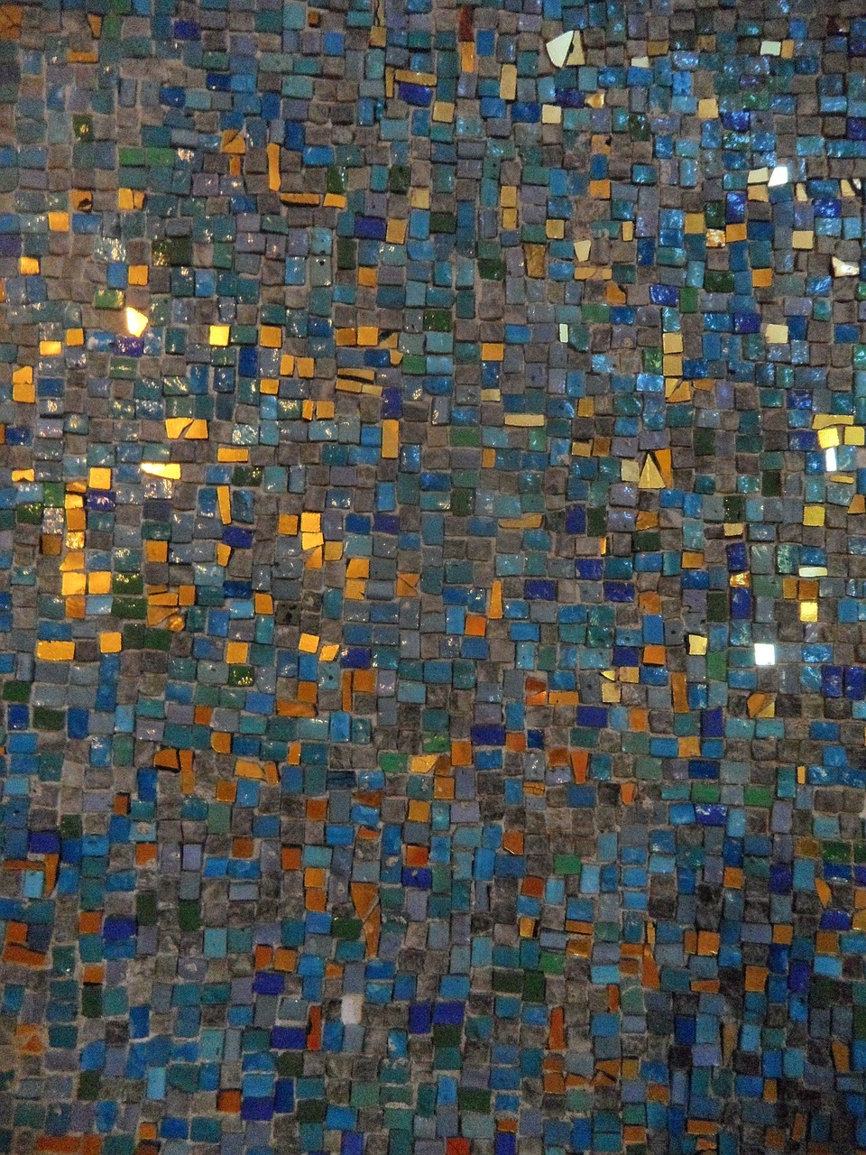
AN EPHESIANS REMINDER OF OUR DIVINE CALLING
“As a prisoner of the Lord, I plead with you to walk holy, in a way that is suitable to your high rank, given to you in your divine calling. ²With tender humility and quiet patience, always demonstrate gentleness and generous love toward one another, especially toward those who may try your patience. ³Be faithful to guard the sweet harmony of the Holy Spirit among you in the bonds of peace, ⁴being one body and one spirit, as you were all called into the same glorious hope of divine destiny. ⁵For the Lord God is one, and so are we, for we share in one faith, one baptism, and one Father. ⁶And he is the perfect Father who leads us all, works through us all, and lives in us all!”
Ephesians 4:1-6 The Passion Translation
Angela shared - I love how Ephesians chapter 4 reminds us, and lays out, our divine calling and destiny as believers. It is simple, yet, profound that Paul says we are ‘joined together as one body, one spirit, one hope, one faith, one baptism and one Father.’
Before the trip to Europe, I knew (in my head) that we are all connected as The Body of Christ. However, fellowshipping with believers face-to-face, heart-to-heart, and experiencing the ‘sweet harmony of Holy Spirit among us’ in Europe, I felt a deeper ‘Ah Ha’ of this gift of unity.
Something inside me stirred with how each one of our daily connections and connectedness, as believers with one another, is an ongoing, active participation of a shared destiny. No matter where we are on the planet, or who we are interacting with, each and every one of our callings and destinies is linked and connected to one another.
“For the Lord God is one, and so are we.” Paul says one. Only one. Not two. Not three. We are One with our perfect Father and we are one with each other. ‘He lives in us all, He is leading us all, and He is working through us all.’ His working in and through you, blesses me and His working through me, blesses you. We need each other’s ‘divine gifts so we can contribute to one another’s growth’ (Ephesians 4:16).
2023 The Warrior Commission © 2023 Frontline This journal is for The Warrior Commission members, who may print it for personal use
& share with friends via email. Written permission is required for any other purpose, for part or all, of its contents

Slide 11
While interacting with members in the Body of Christ in other countries, we shared our mutual love of Jesus in a myriad of ways. Sometimes His working through us was simply a hug, a kind word of encouragement, prayer, worshiping together, crying together, storytelling on travel days, prophetic words, answering questions or laughing over a shared meal. Our team, and the people we met, ‘walked holy with Him and each other in humility, patience, gentleness and generous love.’ It was a tangible and unforgettable ‘bond of peace.’
Weaving the “language of this beautiful chapter” with language to the “divine exchange” that occurred is unfolding. It will take me, and us, time to sort it out. It is something beautifully and infinitely inexpressible currently. Paul had a glimpse of the unity of faith converging with the unity of love and the imprint it can have. I only have a snippet, but I’m forever changed, and hungry, for more of this divine love exchange to invade and transform the earth!
A HEART CRY FOR FATHERS AND MOTHERS!
Kathy shared - Our time in Europe, was a phenomenal life-changing experience for me! Each country we went to - Germany, Denmark and The United Kingdom - were unique and touched me deeply in my spirit. Every person we met was a champion for Jesus, leading on the front line in their countries!
Their passion for Jesus, for their people, and for their country was wholehearted. The people we met greeted us with an abundance of warmth and hospitality! My heart was to listen to the cry of their hearts and the heart of Father God, for their churches, their people, their families, and their countries. It was a great honor and joy to meet them and be with them!
One cry stood out to me throughout each of these countries. Their longing for spiritual fathers to father sons and daughters, raising them up in who they are in Jesus to become fathers and mothers.
“ In the last days, I will pour out My spirit on all flesh; your sons and your daughters shall prophesy, your old men shall dream dreams, and your young men shall see visions.” Joel 2:28
It seems that there is a great cry throughout the world, and in the United States, for a relational family of God to raise up powerful sons and daughters into all they are meant to be in God’s kingdom!
Spiritual parents are needed. Those who love sons and daughters as they equip, empower, and release them to become who they truly are designed, and called, by God to be!
2023 The Warrior Commission © 2023 Frontline This journal is for The Warrior Commission members, who may print it for personal use
& share with friends via email. Written permission is required for any other purpose, for part or all, of its contents

Slide 12
As they grow in intimacy with God, and in identity, “the plastic performance culture would be broken.” He said, “Young people are looking for authenticity, for someone to tell them who they are.” The question was asked by this man, “What would it take to father this nation, to break the fear of inferiority than hinders them?” He shared that he feels there are a lot of leaders but not a lot of fathers and mothers who release people in their identity as sons and daughters of God. This led to another question: what is the difference between mentoring and fathering?
These are profound, thought provoking and important questions. I believe that these questions are being asked by many throughout the earth.
I am deeply grateful for our culture in The Warrior Commission, growing up as sons and daughters of God! The relational style of our community and training that fosters a family culture in our process of growing up is magnificent! What we have here is what the world is crying out for. Intimacy with our God and heart-to-heart relationships that raise one another up in Jesus.
As we lean into our own Father God, we make space for others to encounter and walk with God. But how can we share it with others? There is still much to process and pray about in all the questions mentioned here, but I know that the heart of God is leading us into His wisdom and love in these matters. All so that we can share the awesome love of God and the Good News of His kingdom to His people and raise up His sons and daughters!!
A REAL-TIME OLD-WORLD ADVENTURE
Sharon shared - Stepping off of the plane into Germany was surreal for me. Going to Europe with five of my favorite people was being able to live a dream. The trip had been in the conversation as Directors since 2019 and now was a reality. We said “Yes”, and God created an opportunity. God is so awesome!
Since I’ve been back home, Jesus has been showing me Who He was and Where He was for me over that time out of the United States. As I have processed the days - planes, trains, and automobiles, including ferries and tons of walking, it was all worth it - for the people.
I connected with a woman in Denmark who wasn’t from Denmark but had married a fellow Believer who lived there. She hears the Lord for others so well and translates that into a beautifully creative photography business. Her ability to connect with others opens space for wonderful conversations. God’s presence in her interactions blesses everyone who talks to her.
2023 The Warrior Commission © 2023 Frontline This journal is for The Warrior Commission members, who may print it for personal use
& share with friends via email. Written permission is required for any other purpose, for part or all, of its contents

Slide 13

This was talked about often, especially in Denmark. One pastor spoke that they are “standing at a precipice of time as a people, destitute without fathers and mothers.” His heart desire was to “turn the fathers’ hearts to the sons”. That spiritual fathers and mothers would speak truth and permission to the young people in who they are.
I met a single woman in England who has a cleaning business who received a blessing for the activation we did in Royston. Her life was connected to the deep waters of God and He is her rock. I have since heard from her that she was asked to contribute to a local festival which she did from that deep place with the Lord. On a Saturday evening she played her guitar and sang an old hymn to a Celtic tune sharing the truth of Christ in the middle of this rather pagan festival. I loved hearing from her and her adventure as she brought her “Yes” to God to the table in her local community.
Even though this trip was my first time in Europe, God was the same and people were the same. He loves them all and my privilege was connecting with them as the Lord brought joy and delight. I am so glad I went and will be listening to see if Papa asks me for this kind Yes in the future.
I met an older woman in Germany who so loves the Lord but wasn’t seeing how she could matter. In actuality, she is a huge light in her apartment complex, even with the new refugees and the kids. By the end of the weekend in Karlsruhe, she could see more clearly that she does have a ministry with Jesus. She loves well and she knows He’ll continue to help her know how to love.
Father, thank You for making our why, “Intimacy with God and heart felt connections with each other.”
Through our why, You bring us together as one; a living body we call The Warrior Commission.
You commission us to love You with all we are and to love others as we love ourselves. Thank You for making our TWC experience about this journey into Love. Thank You for immersing our why in love.
Love opens the way for increase.
Love builds connections and bridges.
Love moves mountains and changes us.
Love encourages us to see the best in others.
Love knows no bounds.
Love speaks identity and purpose.
Love commissions us.
Love strengthens us to be tenacious and resilient.
Love develops us into Warriors who release steadfast and resolute love.
Love gives us limitless possibilities as we see the world through Your Love.
You, Lord, are LOVE.
As one within the body of Christ, You empower us to be a dynamic, relational organism. We are unified together in You. We accept Your ongoing commission to embrace our why of intimacy with You as we build heart-felt connections with others. Amen
2023 The Warrior Commission © 2023 Frontline This journal is for The Warrior Commission members, who may print it for personal use
& share with friends via email. Written permission is required for any other purpose, for part or all, of its contents

Slide 14
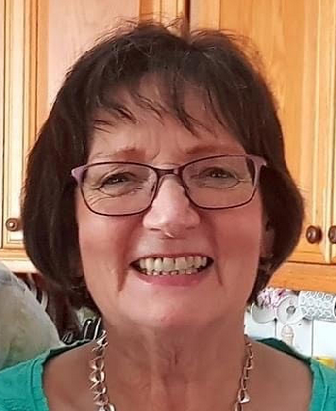


Coaches Corner: THE BEST WORDS ARE ALWAYS HIS WORDS FOR YOU! By Jean Nulty
A couple of questions for you - How do you hear God?
Is it as you read and meditate on His word - do the words jump off the page? Or is it that still small voice, that bubbles up in your spirit? We all hear Him in different ways, for ourselves and others.
God spoke into my life when I went through a very traumatic time; He woke me in the middle of the night and breathed on me! That one thing alone changed my life dramatically. The fact that He cared so much and loved me so much to do this, is still overwhelming! Then, He spoke to me so clearly from Psalm 37: 23 “The steps of a righteous man are ordered by the Lord, and He directs his way.” This was certainly an important inheritance word for me, coming directly from God. It was the beginning of a new journey and a new walk with Him.
In 2017 I ordered books from America and my parcel contained an item describing TWC, so I joined TWC. I can only say it was like finding my home! The training has been amazing. Everyone was so loving, caring, no judgement, only pure love and nothing was too much trouble for anyone! It was during my Champion Training when I became even more grounded in His love and desire for me personally. Knowing how much we are truly loved, regardless of our circumstances, changes us from within.
This year I helped coach other Champions to climb their own mountain with God. I was so honored to be side by side with each one of them on their own personal journeys to listen to their own walk with God and watch them emerge from the cocoon of the caterpillar to beautiful, majestic butterflies. Each person had their own situations and dramatic differences to overcome. God touched them as He knew how, then change happened for each person.
The Lord has been keeping His prophetic promise to me, ordering my steps, and directing my way for myself and others. What inheritance promises has He given you and might Champions training be a part of Him keeping those prophetic promises for you?
2023 The Warrior Commission © 2023 Frontline This journal is for The Warrior Commission members, who may print it for personal use
& share with friends via email. Written permission is required for any other purpose, for part or all, of its contents

Slide 15
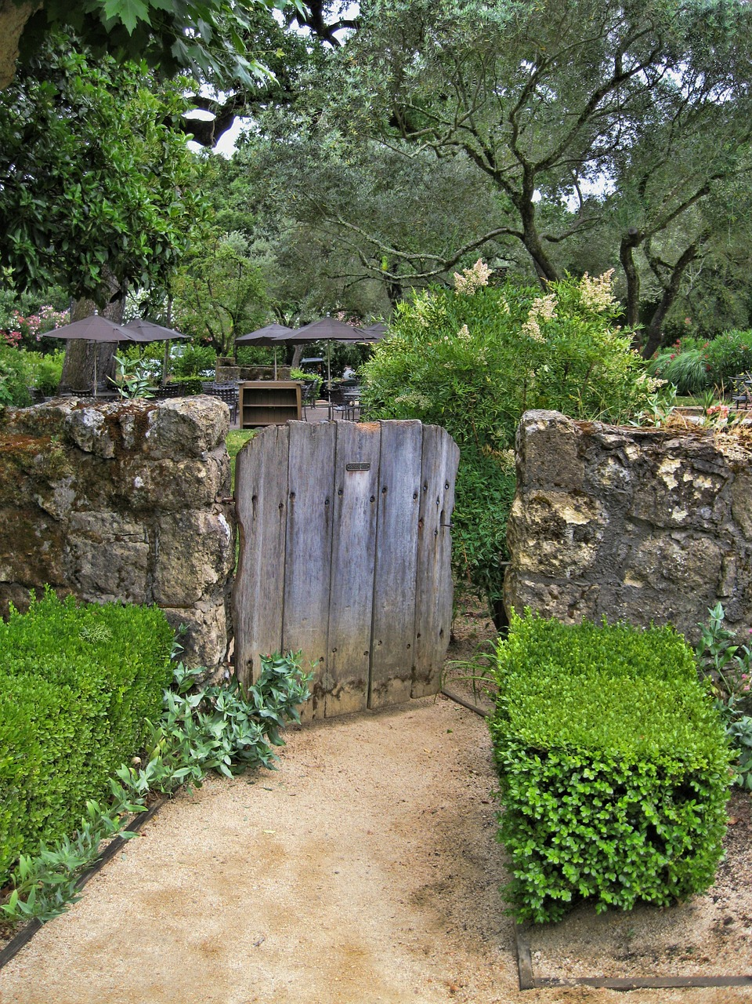

TRAINING HIGHLIGHTS
The Lord has been opening up a picture for The Warrior Commission’s training pathways. TWC’s training starts out self-paced, with some parameters set, like bumpers on a bowling lane to support the designed for outcomes, then as you finish Foundations Stages these bumpers are taken off and you have a plethora of options to explore. We have organized and defined those options on the website under the Empowering Kingdom Influence heading. Some of these training modules you have seen before, some have new names and a few revisions, some are brand new and are just stepping out of the gates. As you check out the Empowering Kingdom Influence subheadings you will get valuable information to help you catch God’s vision for your development within your TWC journey and story.
As we begin the new training year, more will come forward for you each to explore and step into yourselves. It is as if TWC’s training was in a holding tank, a lake, if you will, and the dam on that lake has been carefully taken down. The rivers of Kingdom development that the Lord has designed TWC to carry and release are flowing even more freely now. As we have explored our Identity as a living organism in God’s Kingdom, we have embraced with more intentionality who we are and what God has designed for us. Now is the time for us to run with these insights to help each of you see yourselves more clearly through God’s eyes and embrace your identity and His design and dream for you.
As you consider your development within TWC, the training you have had and are currently mining, here are some questions for you to take to the Lord for conversation:
Since you are running in such a way as to win (1 Corinthians 9:24), what liberty is the Lord revealing to you that needs some refreshing or you may not have seen before?
Is there a How for your journey, or are you still figuring out what being on this journey means for you personally? In our intentionality we have the blessing of being able to dialog with God and partner with His heart for us.
Where does, or where could, your TWC training fit in your relationship with God and your walk with Him in the days He has ordained for you? (Psalms 139:16)
What upgrades does He have for you?
NEW
HORIZONS
2023 The Warrior Commission © 2023 Frontline This journal is for The Warrior Commission members, who may print it for personal use
& share with friends via email. Written permission is required for any other purpose, for part or all, of its contents

Slide 16
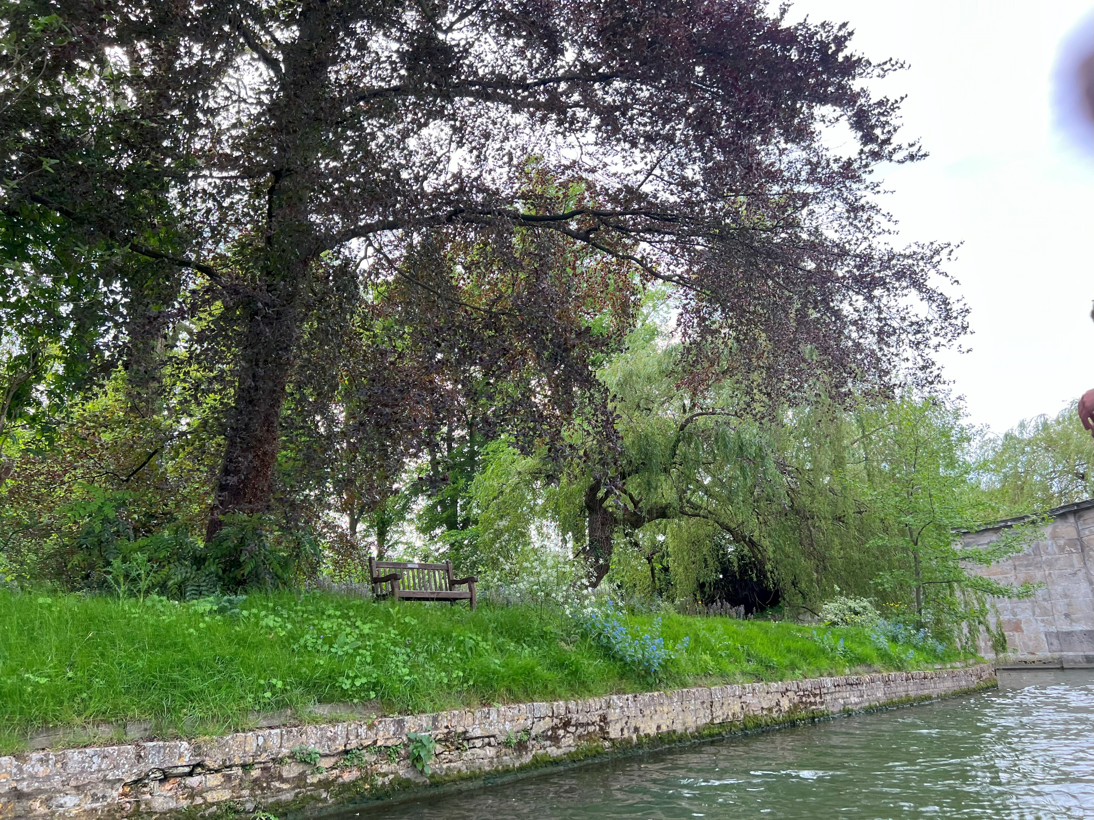
MID-YEAR EBB
JUNE 23 – JULY 9, 2023
REST * REFLECT * RENEW * REFOCUS
It’s time for all our Warriors in The Warrior Commission to move into a Worship Ebb for a few weeks as we prepare for our next training year. We set this time aside to embrace our value of ebb, or resting in Him, as we assess what Father has placed in us this year. It is not a passive time, rather it is a time to pray and seek His heart.
We take time to capture our evidences of transformation for ourselves and for this Warrior EPIC Nation. This also gives our coaches and those working in the background (to keep our operations running smoothly) a chance to rest, prepare, and anticipate what God will do in TWC in the new 2023 – 2024 training year.
2023 The Warrior Commission © 2023 Frontline This journal is for The Warrior Commission members, who may print it for personal use
& share with friends via email. Written permission is required for any other purpose, for part or all, of its contents

Slide 17
Refocus: During this time of rest and reflection, we ask you to ask Abba to help you refocus and reignite your development and growth. Specifically in taking hold of all TWC offers for you and how this development will impact other areas of your life. Use this time to prepare, renew, recommit!
Continue to Pray: God’s plans will come to pass. As we firmly plant in this New Era: pray to go deeper than you ever have in God’s heart. What is God telling you about your next territory and our next step together?
Your Training: Consider if you are to set aside your training, spend time enjoying it to take you deeper, or bring your current module to completion. What are your desires…consider when do you expect to complete your current training? What might be your next step in your ongoing preparation? (Take a peek at Advanced Training Modules, Champion Training, Kingdom Influencer Training and or new Champion Advance! areas.) What direction might God be opening next for your training process, so you begin to have plans for how He wants to develop you next?
Reflect: Reflect on your TWC journey in 2022-2023 and prepare for the new training year. Take time to journal and capture your thoughts. Seek key scriptures for this coming season and ask God what aspect of your identity He will bring forward in this next year. Ask Him Who He will be for you.
Be Refreshed and Renewed: Breathe! Take a walk. Meet with friends. Soak in Him. Find a place or activity that brings refreshing to your heart, mind, and soul. Consider how joy will remain and expand as part of your TWC journey, Warrior Buddies, and training.
To allow space for the deeper reflections for all of us, we take an administrative ebb. Our coaches/admins step into this reflective pause and allow the emails, calls, and posts on Forum and mailboxes to be set aside so they too can enjoy some time of refreshing and renewal.
To start the new training year with celebration
we will gather together on July 15th at 8:00am PDT for an all TWC wide call.
See the Call Blast or Events Tab on Forum’s Warrior Chat
for the Zoom link. We hope to see you there!
2023 The Warrior Commission © 2023 Frontline This journal is for The Warrior Commission members, who may print it for personal use
& share with friends via email. Written permission is required for any other purpose, for part or all, of its contents

Slide 18


Discover and Live Out Your Unique Commission
God calls us to train as Warrior Ambassadors of Love. We are a Kingdom bridge to unconditional love and freedom in Christ. We empower a dynamic lifestyle with God and others.
Our passion to seek God’s heart means He’s our First Love. We believe God expands our capacity to love greatly through abiding rest in Him, training, and ongoing connection, even as seasoned Warriors.
Join The Warrior Commission, find your Commission as a Warrior: one who champions the cause of Christ and influences the world for Jesus in the way He always intended us to!
We encourage you to enjoy this publication of The Warrior Commission’s Frontline.
We created it with you in mind, to support you on your journey with the Lord.
You are welcome to print out a copy for your personal use and
share it with friends or send it to them through email.
If you refer to this publication in a group or talk, please site the source,
and share a little about TWC so others can hear more about us.
WWW.THEWARRIORCOMMISSION.COM - WEBSITE
@THEWARRIORCOMMISSION – FACEBOOK
@TWC_COMMISSION – INSTAGRAM
https://www.youtube.com/c/WarriorCommissionNow - YOUTUBE
2023 The Warrior Commission © 2023 Frontline This journal is for The Warrior Commission members, who may print it for personal use
& share with friends via email. Written permission is required for any other purpose, for part or all, of its contents

